Slide 1
DAP Lead Auditor Training – Appendix
June, 2017
For questions or comments, please contact Ken Berger or Duncan Li

Slide 2
Table of Contents
DAP Programs – p 3-5
Process overview – pp 6
AVD in Flex – p 7
Scope export tool – pp 8-10
Planning Information – p 11
DAP industry coordinators – p 12
UL Travel websites – p 13
DAP Assessment Tool – pp 14-17
DMS for Prior Pathnotes & NCRs – p 18
Datasheet Review – p 19
Agenda – p 20
NCR Review (before audit) – p 21
DAP/MTL database – pp 22-23
GALO requirements – p 24
NCR examples – pp 25-27
Areport – p 28
TMV – p 29
DAP Documents & Tools – p 30-31
Completing Flex tasks – pp 32-36
Audit delegation
Audit planning
Audit
NCR Analysis
CO Review
Issue_DAP_Certificate
TC_Processing
When not in slide show mode, right click on link, then choose ‘open hyperlink’

Slide 3
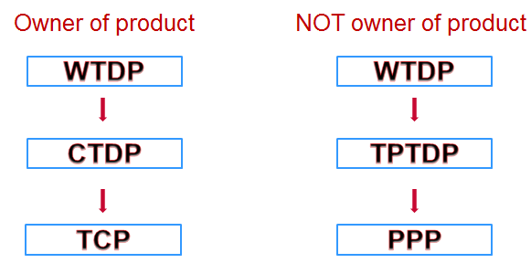
DAP Programs
Witness Test Data Program (WTDP)
Client Test Data Program (CTDP)
Third Party Test Data Program (TPTDP)
Total Certification Program (TCP)
Preferred Partner Program (PPP)
Witnessed Data
Received Data

Slide 4
Comparison of DAP Types
 | UL supervision of testing? | Scope of tests defined? | Annual DAP audit required? | Comments
WTDP | Yes | No | No | Can witness any test UL personnel is qualified for DAP File number not assigned
CTDP | No | Yes | Yes | L-56 Agreement signed prior to participation
TPTDP | No | Yes | Yes | Authorization granted by Regional UL Management & Global Channels Office
TCP/PPP | No | Yes | Yes, and quarterly too | Lab can also do engineering evaluation* Must be part of CTDP for TCP, TPTDP for PPP See 00-OP-S0084
*includes measurement of physical constructions, documentation of physical constructions, development of test plans, & development of engineering considerations to be used for certification purposes
For a detailed description of all types, see - Description of Data Acceptance Programs, 00-OP-S0854

Slide 5
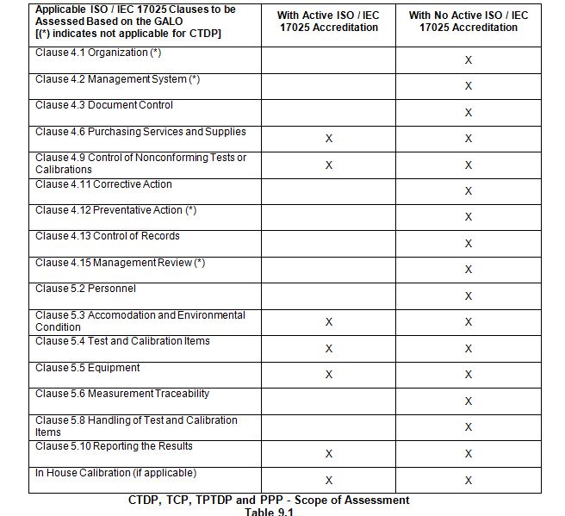
Applicable ISO/IEC 17025 Clauses
- Those clauses with an asterisks do not apply to CTDP.
– The ‘x’ means that the clause applies
- Labs with active accreditation have less clauses applied as shown in the 2nd column.
Table from DAP Program (00-IC-P0026)

Slide 6
UL DAP Audit Process - Main Phases
Quoting/
Opening
Assessing
Closing
DAP CEC:
Handle requests
Use Oracle, Flex
Develop/send quote
Contact client
Direct To Order process used
Delegate audit project to Lead Auditor
Sent client project acknowledgement
DAP Lead Auditor:
Confirm test scope
Obtain Tech Auditor as needed
Prepare agenda
Review past DS & NCRs
Conduct audit
Complete audit report
Update databases
Review client NCRs
Close project
NCB, DAP CEC, RTC:
Extend or inactivate participation
Issue & Send certificate, scope
Upload documents to DMS.
Audit delegation
Audit planning
Audit
NCR Analysis
CO Review
Issue_DAP_Certificate
TC_Processing

Slide 7
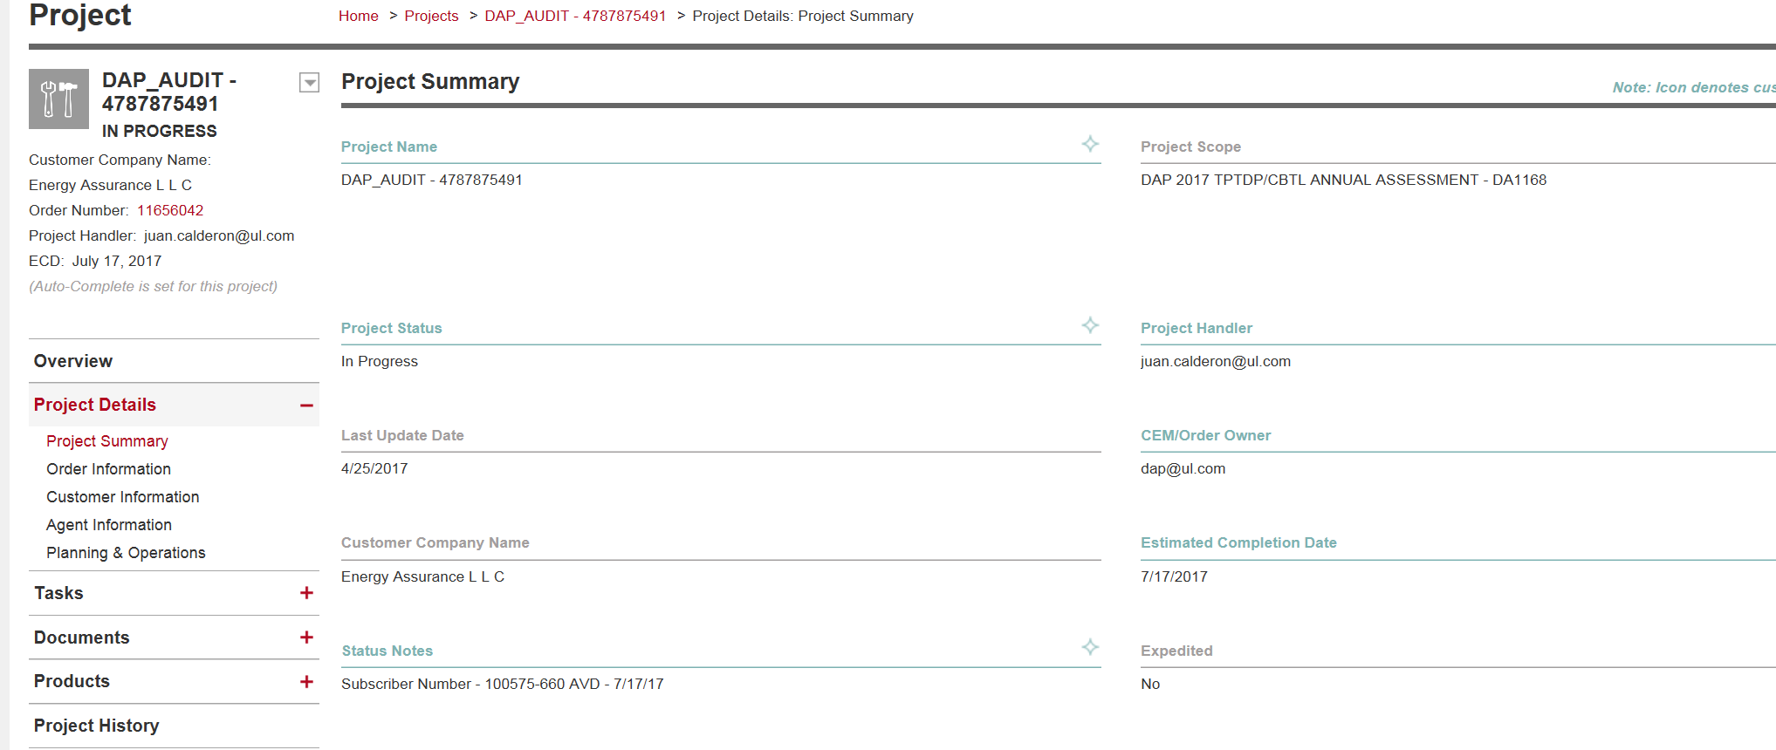
Where is the AVD in Flex?

Slide 8
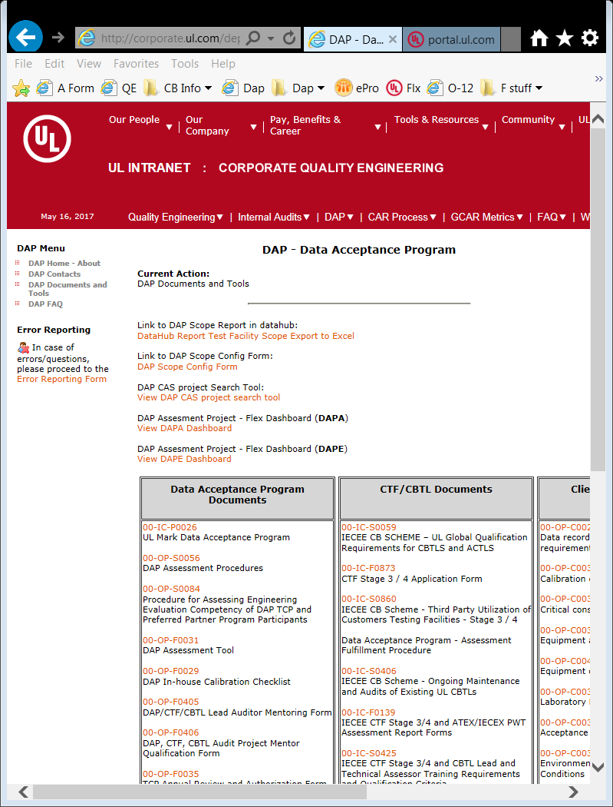
Scope Export - DataHub
http://datahub-reports.ul.com/Reports/report/Ops/DAP/Test%20Facility%20Scope%20Export%20to%20Excel
Link is located in the DAP Audit Tool or you can bookmark.

Slide 9
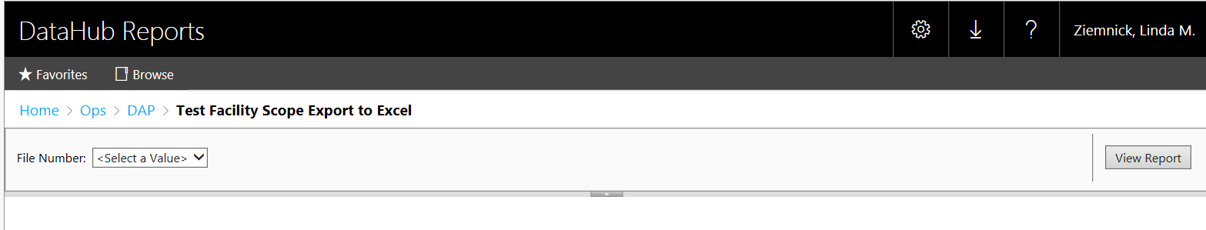
Scope Export
Click on “Select a value” and you will see a list of DAP File numbers.
Find the File Number of the Scope you would like to Export and click on it, then select “View Report” (in the right hand corner).

Slide 10
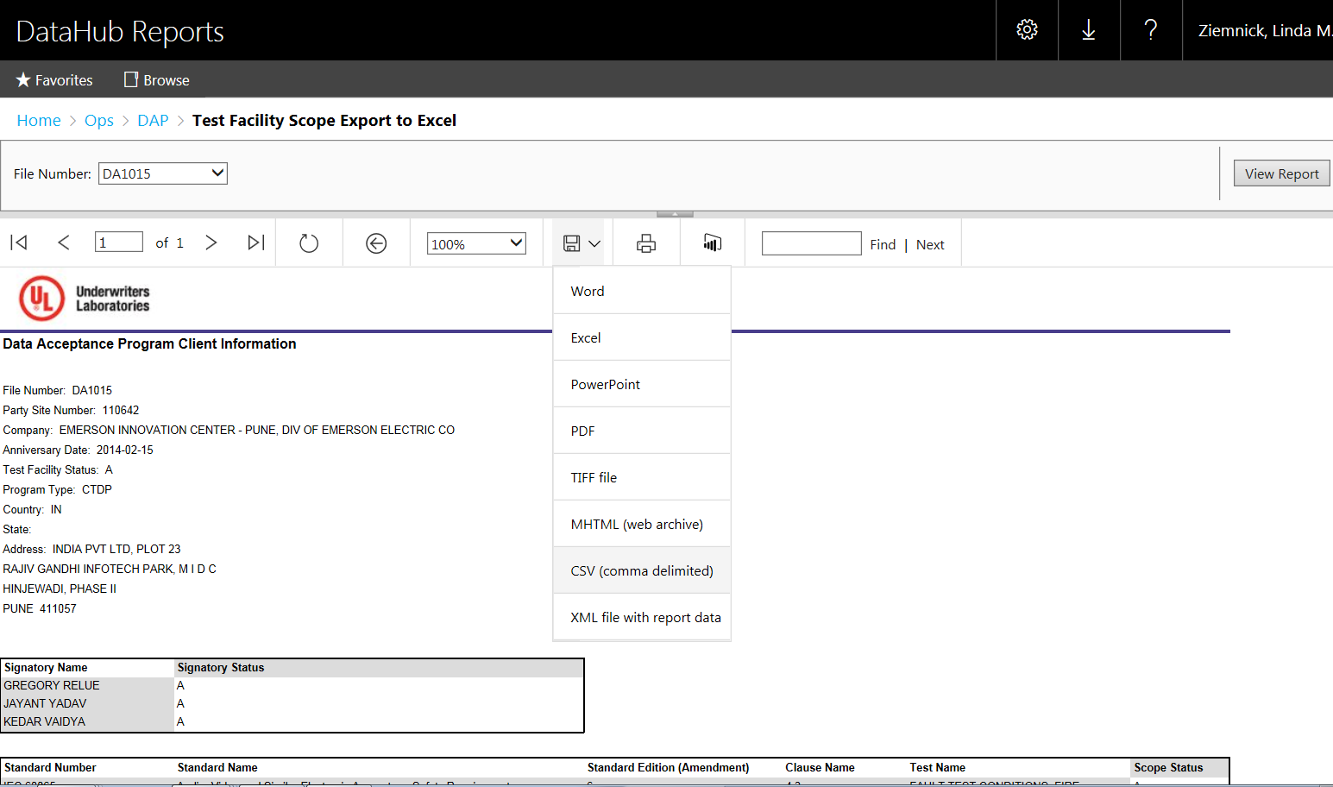
Scope Export
Select ‘Excel’ from the drop down menu and the download will begin.
SAVE the scope report in a convenient location on your computer. File name is up to you.
Make sure it is saved in .xls format to enable it’s import into the DAP Assessment Tool.
Once you have the Scope you need, select “Excel” and click on “Export” to download the scope

Slide 11
Items to verify with the client as a part of planning the audit:
Scope of Participation
Client address
Client contact information (contact DAP@ul.com if different from ePro)
Need for protective equipment (i.e. steel toed shoes, safety glasses)
Changes to the Lab: personnel, test capability, signatories, others
Suggest on-site audit dates per timeline and confirm client’s availability
Communicate number of auditors who will be onsite (based on tests selected for evaluation)

Slide 12
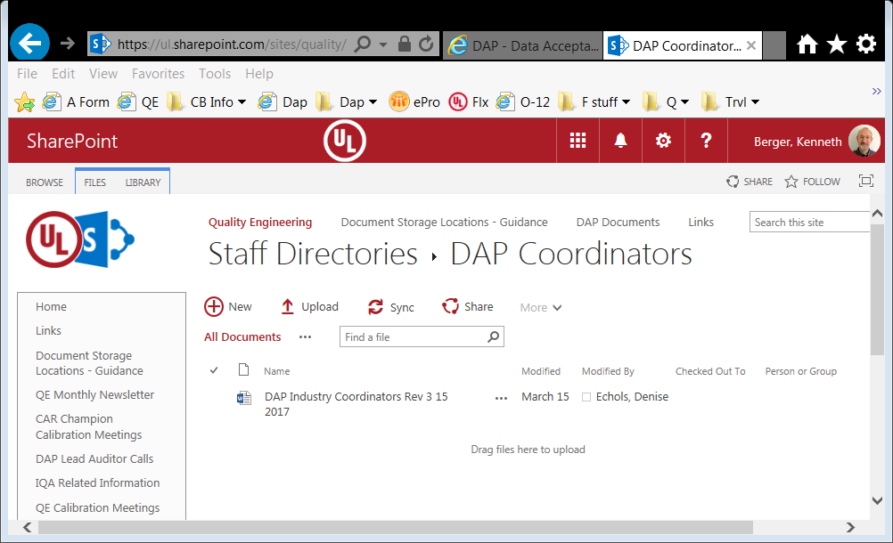
DAP Industry Coordinators
DAP Industry Coordinators list

Slide 13
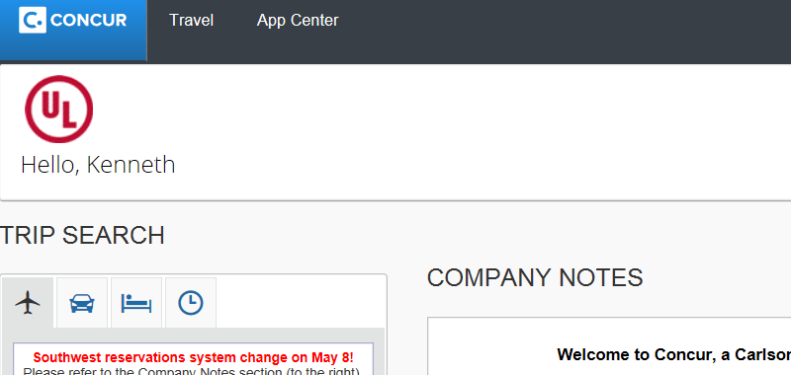
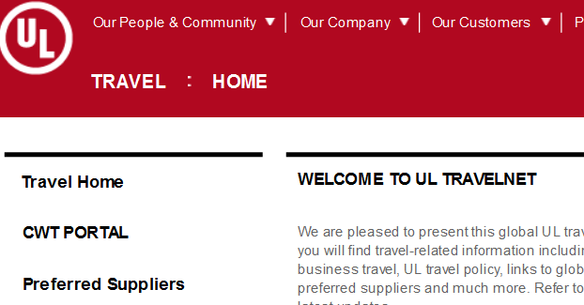
UL Travel sites
Concur website: https://www.concursolutions.com/home.asp
UL Travelnet - http://intranet.ul.com/en/Tools/DeptsServs/Travel/Pages/Home.aspx

Slide 14
DAP Assessment Tool (00-OP-F0031) To Get Started
Obtain the DAP Assessment Tool on QE DAP site under Dap Documents and Tools.

Slide 15
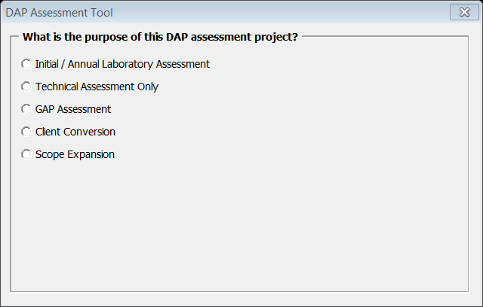
DAP Audit Agenda Preparation
Open DAP Assessment Tool (00-OP-F0031)
Select “Initial / Annual Laboratory Assessment”
NOTE: Documented Instructions on the use of the DAP Tool are contained within Job Aide 00-OP-0042.

Slide 16
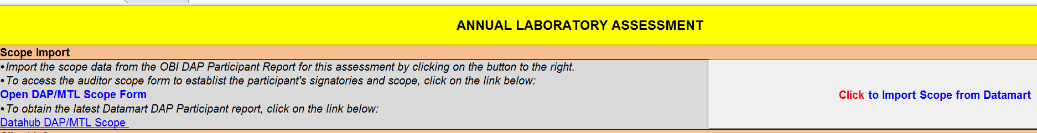
Import Scope into DAP Assessment Tool
Go to “DAP Tool Preparation” tab.
“Click to Import Scope from DataHub DAP Participant Report
NOTE: Importing the Scope will also populate certain information into the DAP Tool (Client Name, Address, etc.)

Slide 17
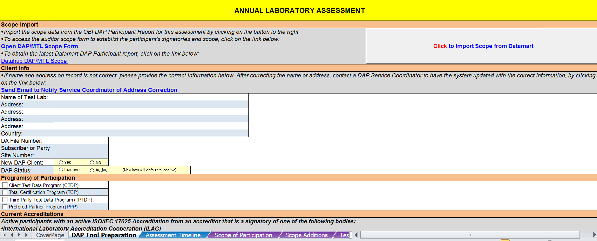
Additional Information Required for Assessment Tool
Most information is entered by hand

Slide 18
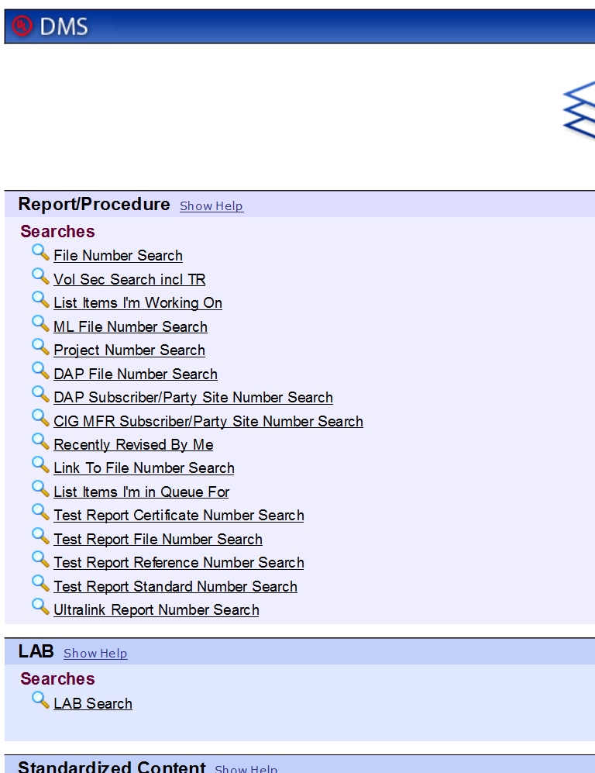
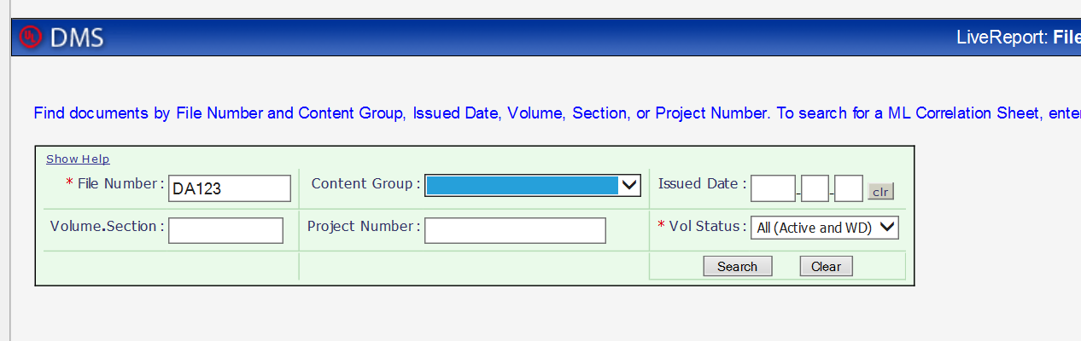
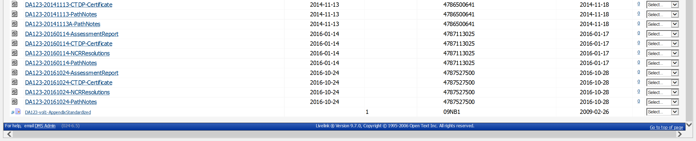
DMS look up for prior Pathnotes and NCR report
Click on “File Number Search” in the DMS home page
Step 1: Enter the file number
Step 2: Content group shall be blank
Step 3: Click on “Search”
1
2
3
Download the Pathnote document from the last two annual audits.
Download the latest NCR documents from the last annual audit
1
2

Slide 19
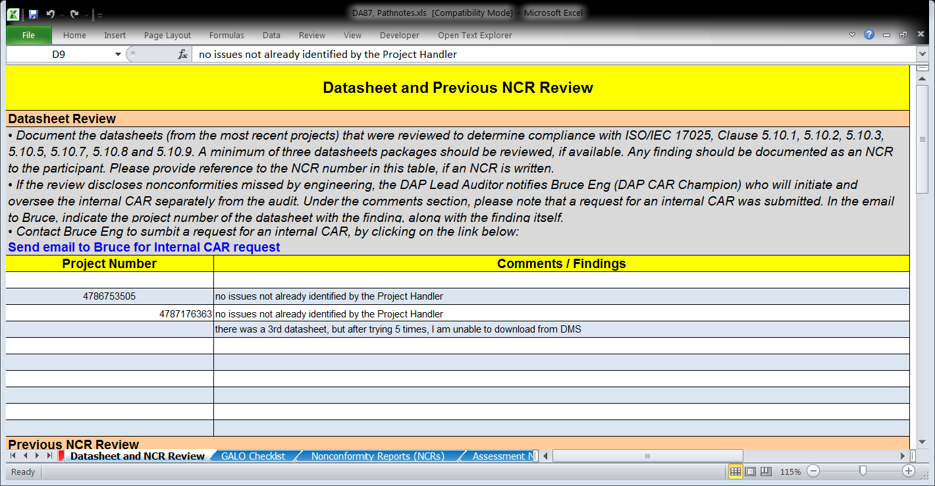
Datasheet Review
Record the following in “Datasheet (5.10) & NCR Review” tab.
Comments – if no problems, write ‘no issues found’
NCR # if one is issued to the client
CAS notification and date, Internal CAR # (if applicable)

Slide 20
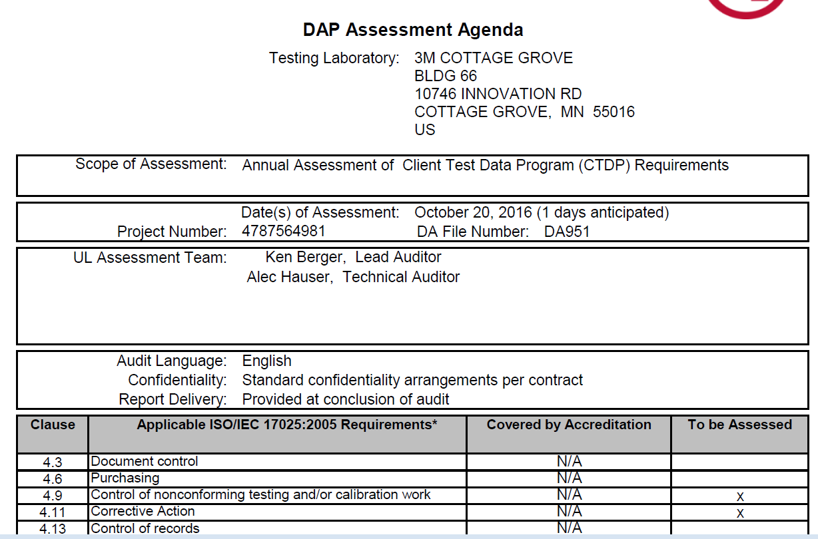
Assessment Agenda – Created from DAP Tool

Slide 21
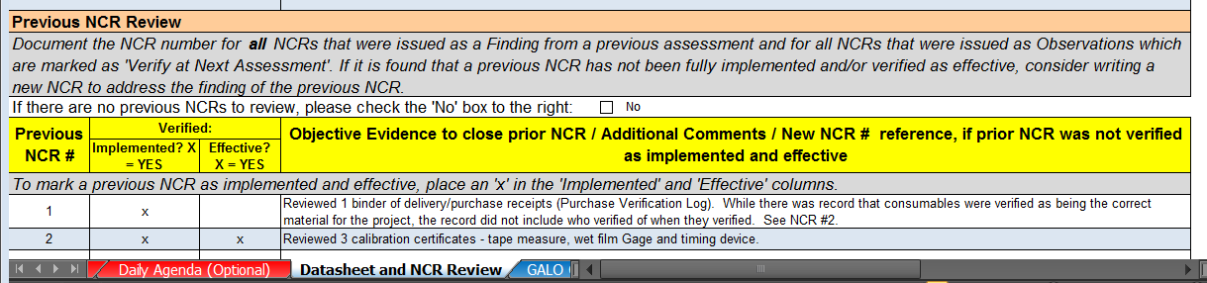
NCR Review Before & During the Audit
Obtain last audit’s NCRs in DMS
Determine which NCRs are open
Record open NCRs in “Datasheet (5.10) & NCR Review” tab.

Slide 22
Working with the DAP/MTL database
For updating tests & signatories in a lab’s scope
Note: for more details, see the ComplianceWire module: “DAP-MTL Lab Scope Refresher Training”

Slide 23
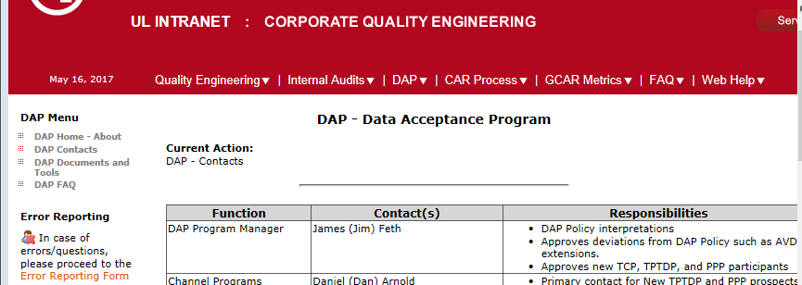
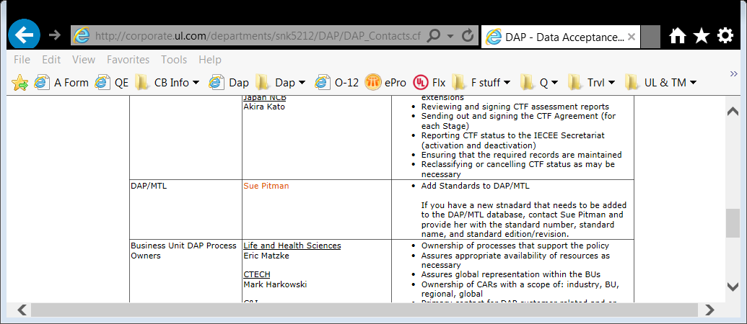
Working with the DAP/MTL database
For adding new standards or editions

Slide 24
What information is required in the GALO?
Record determination of compliance for EVERY row
If a requirement is determined “N/A”, a comment is needed to support
Record Procedure and Revision Level, as required (see “Note” in 1st column “ISO17025 Based Requirements & Guidance” for guidance)
Reference all NCR #s to the applicable clause(s) it was written against
Compliance is marked “No” for all NCRs
NOTE: cells use color as warning: row will turn green when information is entered in appropriate columns.
See 00-OP-J0042, DAP Assessment Tool User’s Guide for requirements

Slide 25
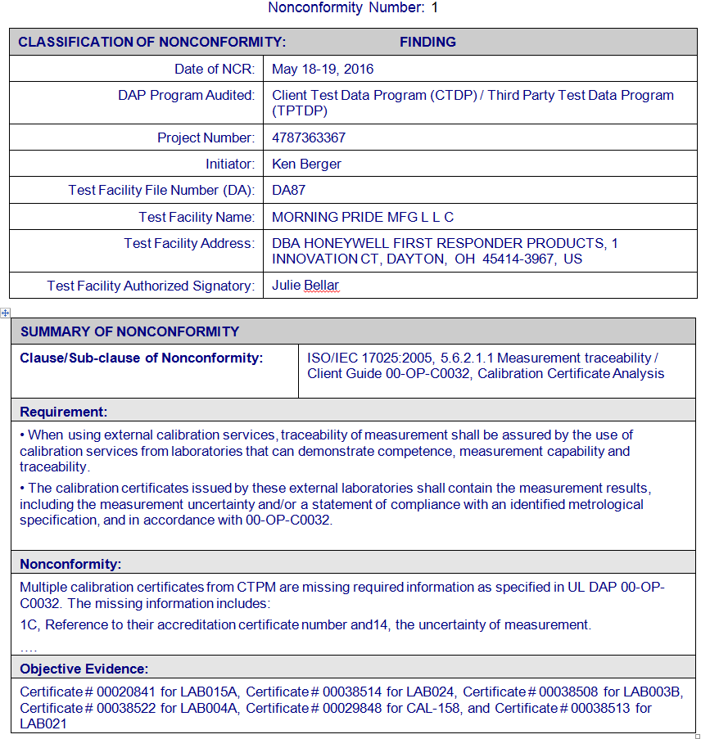
DAP Assessment Tool Creates NCR Report
Header
Classification and NCR #
Participant, audit info
Summary of
Nonconformity
17025 clause/sub-clause/ standard/client guide
Requirement
Nonconformity
Objective evidence

Slide 26
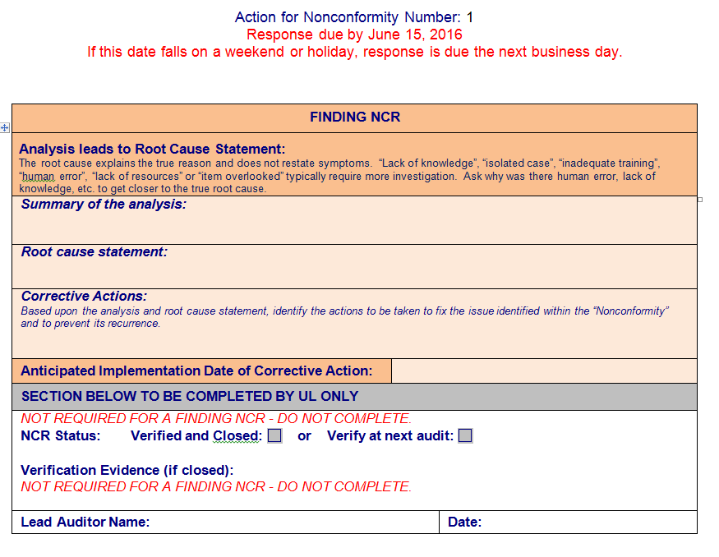
Features of the NCR Report (Finding)
Section completed by client
Root cause and analysis summary
Corrective action(s)
Anticipated date
Section completed by UL

Slide 27
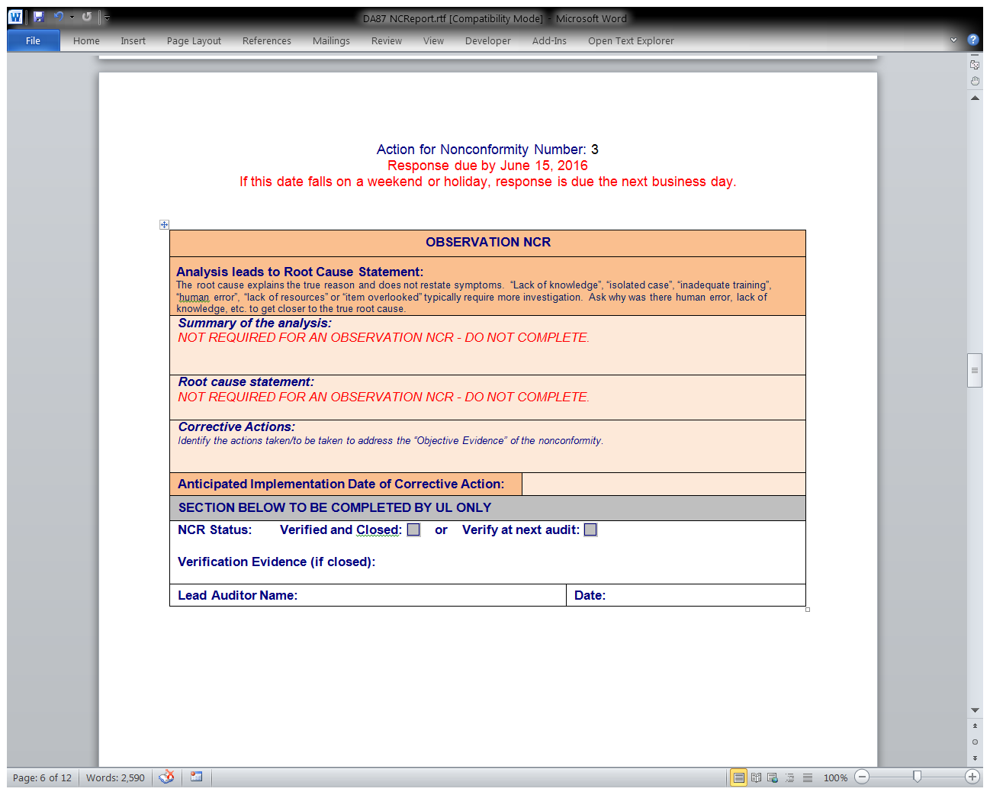
Features of the NCR Report (Observation)
Section completed by client
Root cause and analysis summary
Corrective action(s)
Anticipated date
Root cause and analysis summary
Section completed by UL

Slide 28
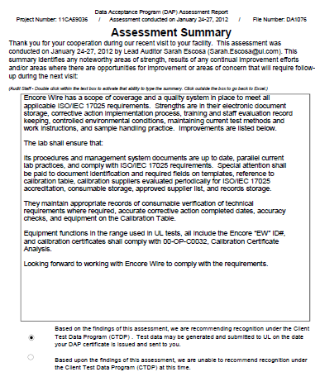
DAP Audit Report – Assessment Summary
Be sure to include:
Areas of Strength
Results of any Continuous Improvements
Opportunities for Improvement
Areas of Concern
Select Participation Recommendation
Important details for THIS audit

Slide 29
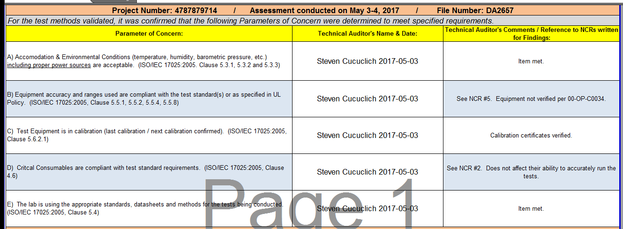
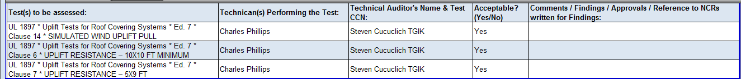
TMV Example

Slide 30
DAP Documents & Tools
QE DAP site has the following:
DAP Scope Config Form – for updating scopes
Datahub Reports - DAP Reports for scope & completed Datasheet list
http://corporate.ul.com/departments/snk5212/DAP/DAP_Documents.cfm
Notes:
Some of the major documents & tools

Slide 31
DAP Documents & Tools
QE DAP site has the following:
DAP Assessment tool - 00-OP-F0031 (also on DCS)
DAP SOPs – also on DCS
DAP Client Facing documents – also ul.com/dap
DAP FAQs
DAP Contacts
For more info on DAP programs, see the external UL site: http://services.ul.com/service/data-acceptance-program/
Notes:
Some of the major documents & tools

Slide 32
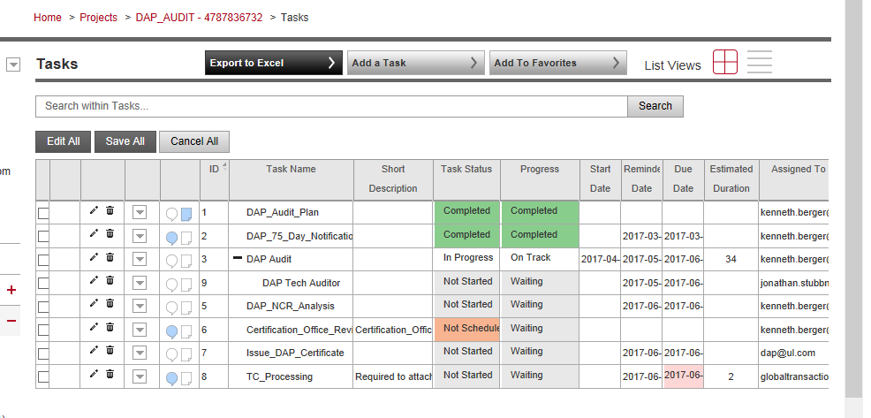
Completing Flex Tasks
Note: see next slides for details on each task

Slide 33
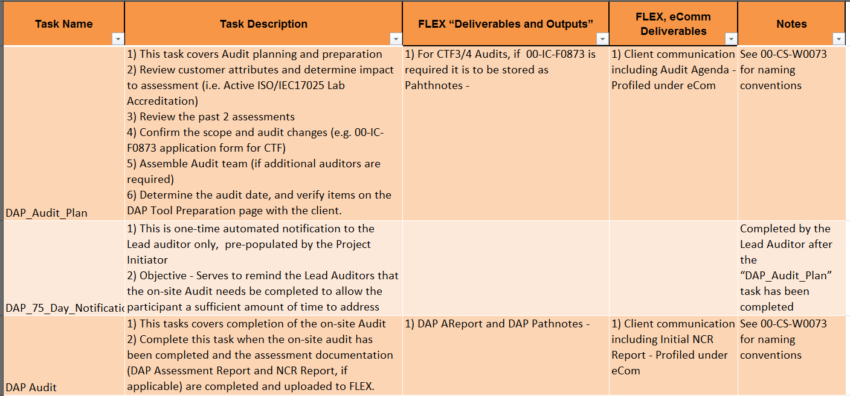
Flex Table guide
based on 00-OP-S0056 Issue # 14, see current SOP for the latest requirements

Slide 34
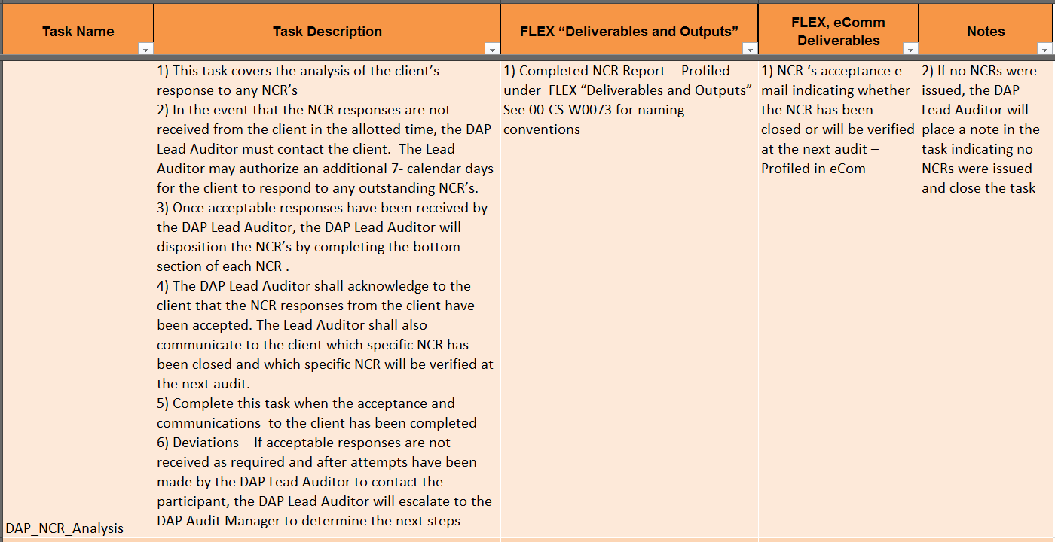
Flex Table guide
based on 00-OP-S0056 Issue # 14, see current SOP for the latest requirements

Slide 35
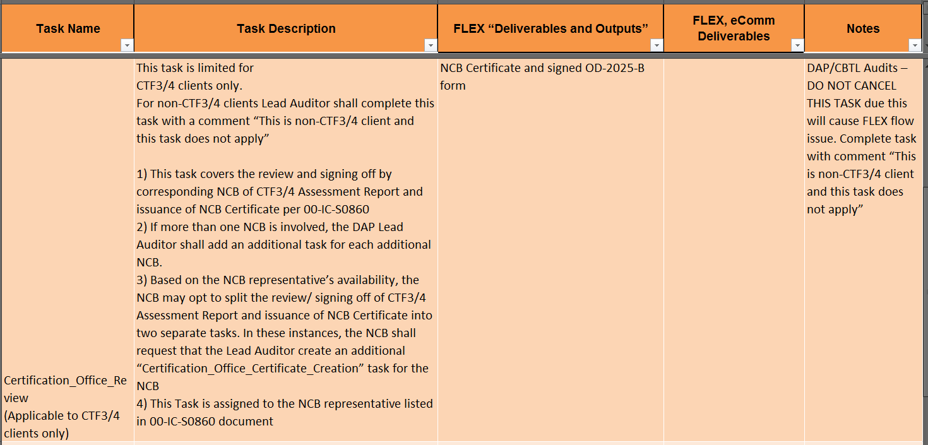
Flex Table guide
based on 00-OP-S0056 Issue # 14, see current SOP for the latest requirements

Slide 36
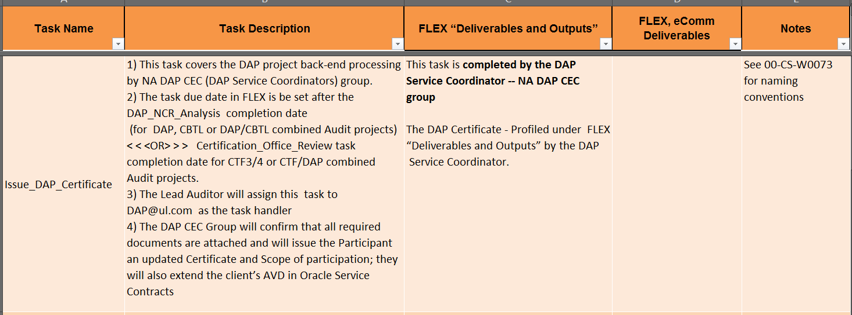
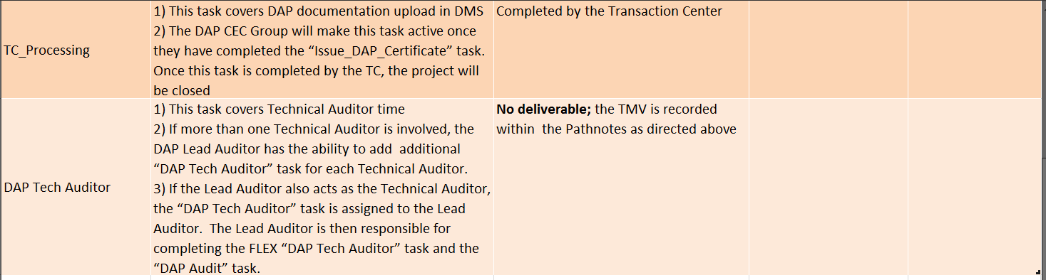
Flex Table guide
based on 00-OP-S0056 Issue # 14, see current SOP for the latest requirements

